Slide 1





Introduction
With our system we are trying to understand connections between crime scenes and sounds involved in those scenarios for better enforcement of law and order.
The dataset is acquired from Urban8Ksounds.
Dog Bark
Jack Hammer
Glass Breaking
Drilling
Gunshot

Slide 2

Objective
To recognize the pattern of sounds in crime scene using MFCCs (Mel-Frequency Ceptrum Coefficients) spectrogram and feeding them to CNN model for predictions, generating alert on detection of sound.

Slide 3

Related Background
Pattern recognition is a one of the branches of AI and subsection of Machine learning and is a study of how machines can observes the environment, learn to distinguish the patterns of interest from their background and make decision about categories of the pattern.

Slide 4
Expected Outcome
Our system will take user input of audio files and based on this audio files we can recognize the particular audio pattern.

Slide 5
Tools and Technology
Software Requirement:-
HTML5-HTML
CSS
Python Flask,keras,tf
Jupyter Notebook(for backend),Notepad++
IDE/Text Editors(VSCode)
MySQL, Wampp server
Jenkins
Used for Platform Access:-Web Browser

Slide 6
Hardware Requirement
Windows 7 or above
Minimum Ram Requirement:- 512 MB
Minimum HDD Requirement:-1 GB
Required intel 32 or 64 bit

Slide 7
Modules
Sign-Up:-
In this module user create an account for the system. After successfully created account all information store in database.
Fields:-
Username , Email , Password , Confirm_Password.
Login:-
After Sign-Up user retrive data from database and easily login in the system.
Fields:-
Email and Password.

Slide 8
Modules
Analysis:-
In this module user upload the audio file like Dog barking,gun-shot, glass-breaking . After uploaded audio file system recognize which sound in uploaded audio file.In this part all uploaded file store into uploads folder.
Logout:- After Audio Analysis user can logout.after logout user cant access analysis page.For access analysis page user first login.

Slide 9
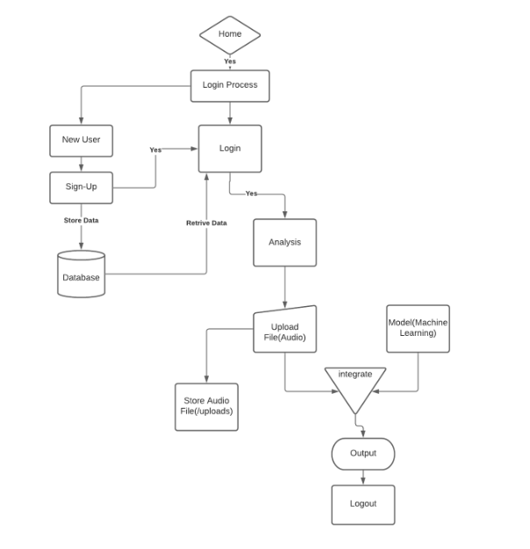
Flow-chart

Slide 10
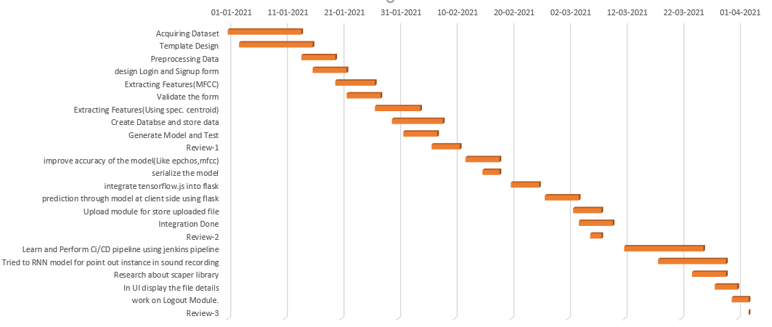
Timeline chart

Slide 11
Algorithms

Slide 12
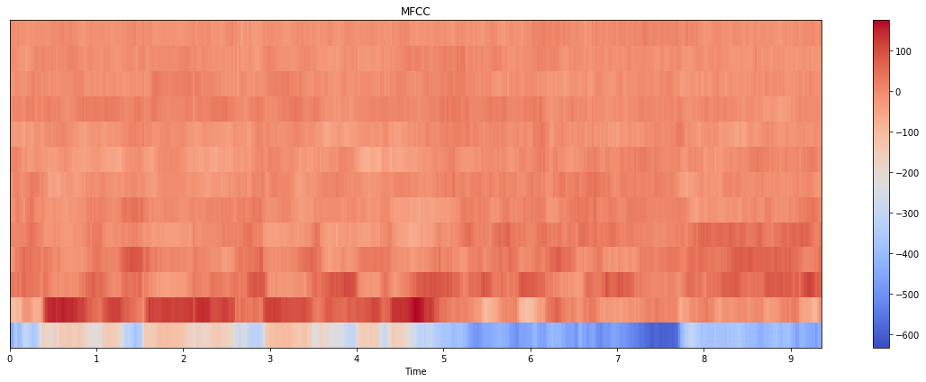
Feature Extraction
MFCC
MFCCs use Mel scaling to try to model the way that the human hearing auditory system perceives sounds, rather than describe them on a purely frequency (Hz) basis.

Slide 13
Model Algorithm
CNN
A Convolutional Neural Network (ConvNet/CNN) is a Deep Learning algorithm which can take in an input image, assign importance (learnable weights and biases) to various aspects/objects in the image and be able to differentiate one from the other.

Slide 14
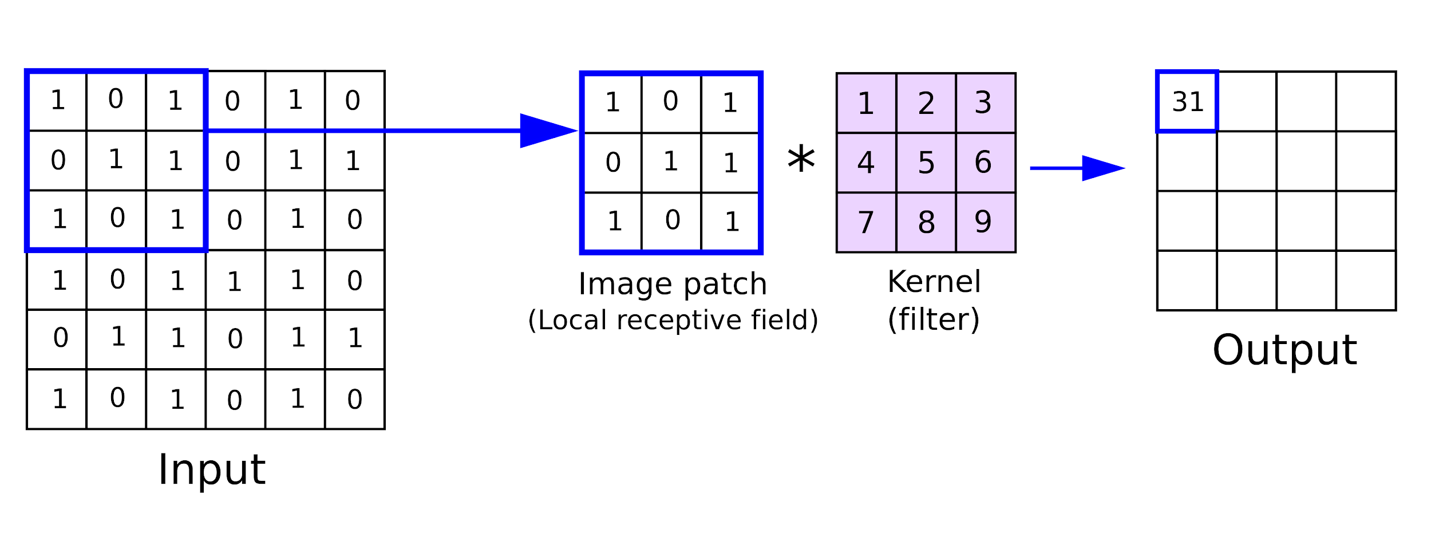


CNN Extension
Addition of Filter for better efficiency.
Previous
Now

Slide 15
Implementation Details

Slide 16
Voice Classification Model
Modifying Metadata
Merging names, directory name, class of newly glass breaking .wav files. [using excel]
Feature Extraction
A function iterate over dataset to calculate MFCCs and store them into dataframe. [using librosa,tensorflow,pandas]
Compile Model
3 dense layers including 1 dense output layer corresponding to 5 classes. [using CNN, Adam]

Slide 17
Voice Classification Model
Accuracy Check
Training and Testing accuracies are checked in order to satisfy the proper classification and model is saved for prediction. [using model.evaluate() method]
Testing Model
Features are extracted from test file and cross-validated against the trained features. [user defined functions print_prediction and extract_feature]

Slide 18
User Interface
Flask Components:-
Index.html:- User is prompted to upload the file.
recapp.js:- Handles the file and store it.
Commons.py:- Contains functions to handle the file and carry out the prediction.
Application.py:- Handles core functionality of ui. Also, invokes other files.

Slide 19
Jenkins Pipeline
Jenkins Pipeline is a suite of plugins which supports implementing and integrating continuous delivery pipelines into Jenkins.
Continuous Integration:-
The "CI" in CI/CD always refers to continuous integration, which is an automation process for developers. Successful CI means new code changes to an app are regularly built, tested, and merged to a shared repository.

Slide 20
Continuous Delivery
Continuous delivery is an extension of continuous integration since it automatically deploys all code changes to a testing and/or production environment after the build stage.

Slide 21
Steps for Jenkins Pipeline.
Steps:-
Create jenkinsfile.
Two steps to write Pipeline Script(Declarative or syntax)
All project files with requirements.txt and jenkinsfile upload on github repoisitories
Github repositories connect with Jenkins.
Apply Poll SCM in Jenkins for updated commit.

Slide 22
User Interface
Process
Storing uploaded file:- On upload, js script handles file and direct it to a folder for storage.
Features Extraction:- With user defined function, librosa extracts MFCCs.
Recognize Sound:- The extracted features are mapped within the modeland system recognize the sound.

Slide 23
User must login in order to access the system.
Usage of print_prediction and extract_feature methods.
The input sound belongs to which class.
Login
Input
Model
Classification
Output
The recorded sound file is uploaded to system.
Based on feature, classify sound into 5 classes.

Slide 24
Conclusion
End-Users can easily classify the sounds regarding robbery and crime using our system.
On optimization, the system will be helpful for analyzing crime scenes.

Slide 25
References
Kdnuggets
Medium
Youtube
Keras and tensorflow [github and documentations]

Slide 26
Reference Link
https://machinelearningmastery.com/softmax-activation-function-with-python/
https://www.youtube.com/watch?v=wQ8BIBpya2k&ab_channel=sentdex
https://www.kdnuggets.com/2020/02/audio-data-analysis-deep-learning-python-part-1.htm

